Slide 1
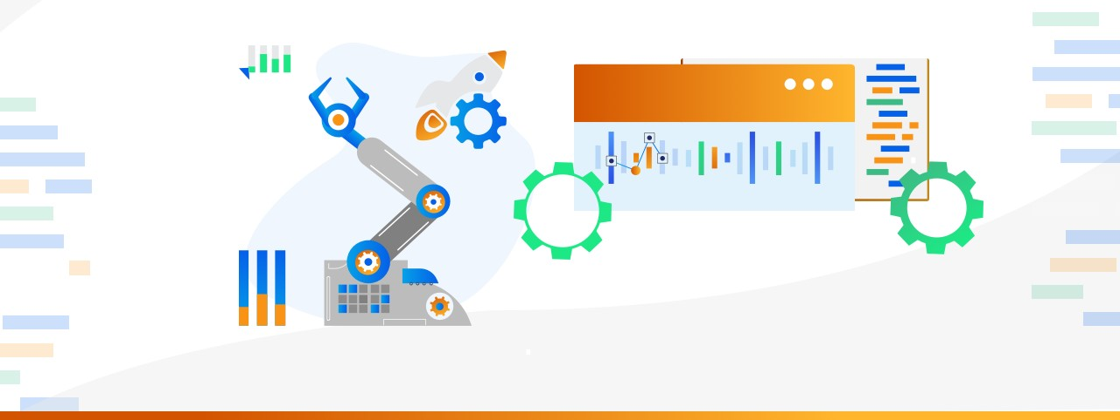

Graduation Project on manufacturing Downtime Analysis
Presentation by
Kareem Ashraf
Mahmoud Walid
Muhamed El-sakka
Muhamed Shokry
Jihad Ismail

Slide 2


🚀 Project Idea
Manufacturing downtime leads to reduced productivity and increased operational costs. This project addresses the issue by analyzing production data to identify root causes of downtime, measure efficiency, and highlight performance gaps. What sets this project apart is its dual-layered analysis of both human and non-human error contributions, enabling more targeted and effective improvement strategies.
4/10/24

Slide 3
🔹 End Users + Features
👥 Primary User Personas
⚙️ Key Features That Address User Needs
✅ How Features Solve User Problems
Operations Managers – Monitor downtime trends and production performance.
Maintenance Teams – Analyze error types for preventive maintenance.
Production Supervisors – Track efficiency by shift and decisions operator.
Executives – Need high-level insights for strategic.
Downtime Cause Analysis
Shift & Operator Performance Tracking
Batch & Product-Level Efficiency Metrics
Human vs. Non-Human Error Classification
Target Efficiency Monitoring
Interactive Dashboards
Helps managers identify top causes of downtime and improve planning
Supports maintenance teams in detecting patterns in recurring issues
Enables supervisors to compare performance across shifts and operators
Provides executives with clear, visual KPIs for decision-making
4/10/24

Slide 4

📁Data Structure
The dataset is stored in an Excel file and structured in a tabular format, like a relational database. Each row represents a single production batch and includes details such as product name, operator, start and end times, duration, and efficiency.
Key Entities and Relationships:
•The main entity is the Batch,
•Linked to Product, Downtime (with reasons and descriptions),
•Time-related data like shift and hour,
•And Operator performance.
4/10/24

Slide 5
📁cont’d: Data Structure
Data Flow:
Data is collected during the manufacturing process, stored in a structured format, and accessed for analysis using Python. The pandas library was used for data cleaning, datetime handling, table merging, and calculating performance metrics (e.g., efficiency, downtime with/without human errors).
The file was originally in CSV format, and the data contained missing values, but we transformed it using Python for cleaning and SQL for analysis. It is now tabular, free of missing values, evenly distributed across shifts, workers, and products, and has undergone various techniques such as time classification, aggregation, joins, and conditional analysis.
4/10/24

Slide 6

Programming Languages + Frameworks
Python
SQL
• Cleaned and preprocessed time and downtime data for analysis.
• Calculated production duration and classified shifts by start time.
• Mapped and analyzed downtime factors with human error categorization.
• Calculated multiple efficiency metrics, including those excluding human errors.
• Mapped minimum batch time per product and evaluated operator lagging efficiency.
•Calculated average efficiencies per shift and ranked shifts by total downtime.
•Ranked batches per product based on downtime.
•Compared operator performance across batches using LEAD.
•Summarized downtime and efficiency metrics by product and batch using ROLLUP.
4/10/24

Slide 7
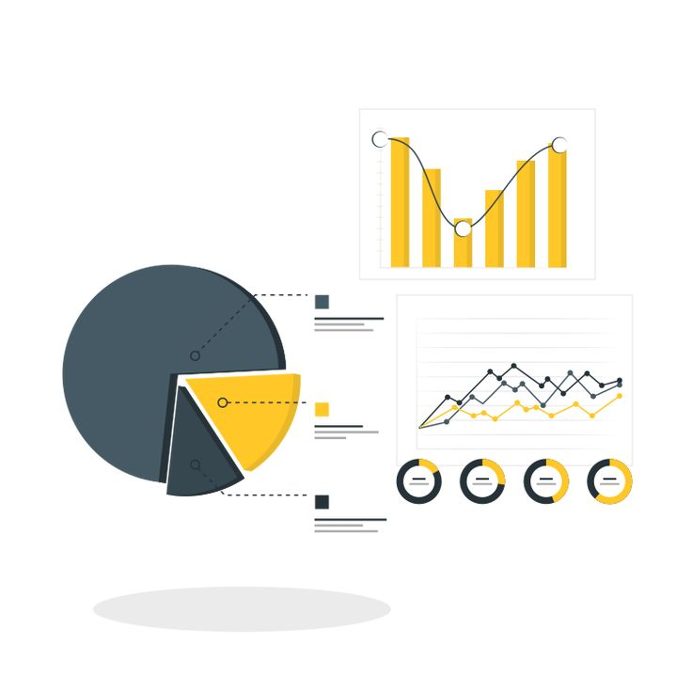
Project Workflow & Tools Used
We received raw production data in multiple Excel files. These were combined and cleaned using Python .Then, SQL was used to analyze trends, efficiency, and downtime patterns. Finally, dashboards were created in Power BI to visualize performance insights interactively.
4/10/24

Slide 8

Deliverables
Final presentation and summary report Timeline:
Deliverables:
•Week 1: Build Data Model, Data Cleaning and Preprocessing
•Week 2: : Analysis Questions Phase
•Week 3: Visualization Dashboard and Final Presentation
•Cleaned and merged dataset
•Python scripts for preprocessing and cleaning
•SQL queries used for analysis
•Power BI dashboards visualizing key metrics
Other Outputs:
Final report and presentation
4/10/24

Slide 9

Project Team + Roles
No | Team Member | Role & Responsibilities
1 | Karim Ashraf (Team Leader) | Oversees project execution, ensures milestones are met, and coordinates team efforts.
2 | Mahmoud Walid (Data Cleaning & Preprocessing) | Standardizes datasets, resolves inconsistencies, and prepares data for analysis.
3 | JIhad Ismail (Questionnaire & KPI Framework) | Defines performance indicators and analytical objectives for downtime insights.
4 | Mohamed Shokery (Data Validation & Consistency) | Ensures data accuracy and cross-verifies analytical results.
5 | Mohamed Elsakka (Visualization & Dashboard Development) | Builds interactive dashboards to provide real-time insights into downtime trends.
4/10/24

Slide 10

4/10/24

